Slide 1
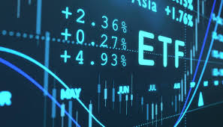
Data Science & AI Capstone Project
Girish Pandit
Signal that speaks
Empowering Novice Investors with Data Driven
Insights in ETF (Exchange Traded Funds) Investments

Slide 2
BIO
Education : Bachelors in Mathematics / Master’s in Management / Failed – Masters in Financial Engineering
Professional Experience : Deutsche Bank, Corporate Bank (since ages)
Other : Novice Investor & Analytical Explorer

Slide 3
AGENDA
OBJECTIVE
EXPLORATORY DATA ANALYSIS
MODEL EVALUATION
SUMMARY & CONCLUSION
NEXT STEPS

Slide 4
A Story from Pain to Purpose
Few year ago…
Saving invested in some stocks back of friendly tip went sour. Lost money. Lost sleep. Felt Lost.
What if I had something smarter to cut through the noise and guide me ?
A system that could help me answer:
Is the price likely to rise in the coming days ?
Should I act on this information now or wait ?
Will my decision be stable for some time ? Is this a steady opportunity, or should I brace for sharp swings ?

Slide 5
Objectives & Stakeholders The pain became the spark for a purpose – to build something better
Predict ETF price movement over next 7 days to help investors stay ahead
Deliver clear investment signals – Buy, Hold or Sell over next 7 days.
Providing early warning on market volatility over next 7 days to enhance risk awareness and confidence.
Key Stakeholders :
Novice / First time Investors
Digital Investment Platform (e.g., Robo-advisors)
Financial Advisors / Educators
Compliance & Risk Professionals

Slide 6
ETF Demystified
ETF or Exchange-Trade Fund is type of investment fund that holds a collection or basket of assets – such as stocks, bonds or commodities – that you can buy or sell on a stock exchange, just like regular stock. It helps you to invest in many companies at once.
Key Features :
Diversification : One ETF can give you exposure to dozens or even hundreds of company stocks.
Trading : Can be bought or sold like a normal shares in stock exchanges.
Lower Fees : Lower management cost than mutual funds.
Transparency : Most ETFs disclose their holdings, so you exactly know what you own.
Flexibility : Invest in focused ETF such as sector, theme or geographies.

Slide 7
Dataset Description
Daily Open, Close, High, Low, Volumes for Top 10 ETFs from Yahoo Finance for last 10 years. i.e., 11 April 2015 – 11 April 2025. Contains 25170 records with 7 features.
SPY | SPDR S&P 500 ETF Trust
QQQ | Invesco QQQ Trust
GLD | SPDR Gold Shares
TLT | iShares 20+ Years Treasury Bond ETF
VTI | Vanguard Total Stock Market ETF
EEM | iShares MSCI Emerging Markets ETF
XLF | Financial Select Sector SPDR Fund
XLV | Health Care Select Sector SPDR Fund
VEA | Vanguard FTSE Developed Market ETF
VNQ | Vanguard Real Estate ETF

Slide 8
Feature Engineering -Financials
Features | Basics | Description
High / Low / Close / Open / Volumes / Date | Price Based Features | Daily prices, Volumes traded per day and the price date
Return | Price Based Features | Daily Percentage Return on the Close price
True Range (TR) | Price Based Features | True Range – Maximum (High-Low, High – Previous Close, Low – Previous Close)
Average True Range (ATR) | Volatility Indicators | Average True Range over 7 days – measures Volatility
Volatility | Volatility Indicators | Rolling 7 – day standard deviation of Returns
MA5 | Moving Average | Simple 5 –day moving Average
Close MA5 Diff | Moving Average | Difference between current close and MA5 (short term momentum)
SMA20/50/200 | Moving Average | Longer Horizon simple moving averages
EMA20/50/200 | Moving Average | Weighted Averages that gives importance to recent prices
RSI | Technical Indicators | Relative Strength Index – Momentum oscillators (typical overbought > 70, oversold <30)
MACD | Technical Indicators | Moving Average Convergence Divergence (12 EMA – 26 EMA)
Signal Line | Technical Indicators | 9 days of EMA of MACD (used to generate buy / sell signals)
%K, %D | Technical Indicators | Stochastic oscillators – momentum indicators to detect reversal points
Day of Week | Time Based Features | Encoded day of week (0=Monday)
Month | Time Based Features | Encoded Calendar Month
IsMonthEnd | Time Based Features | Binary flag indicating if it’s the last trading day of the month

Slide 9
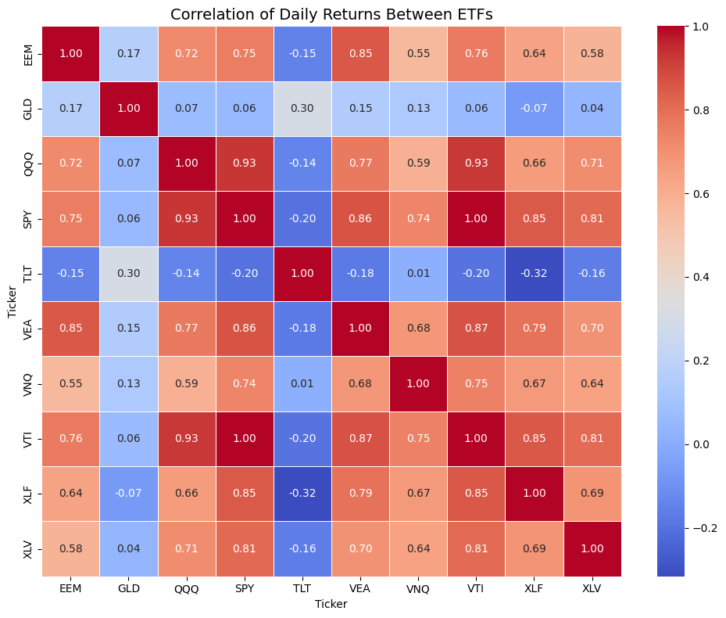
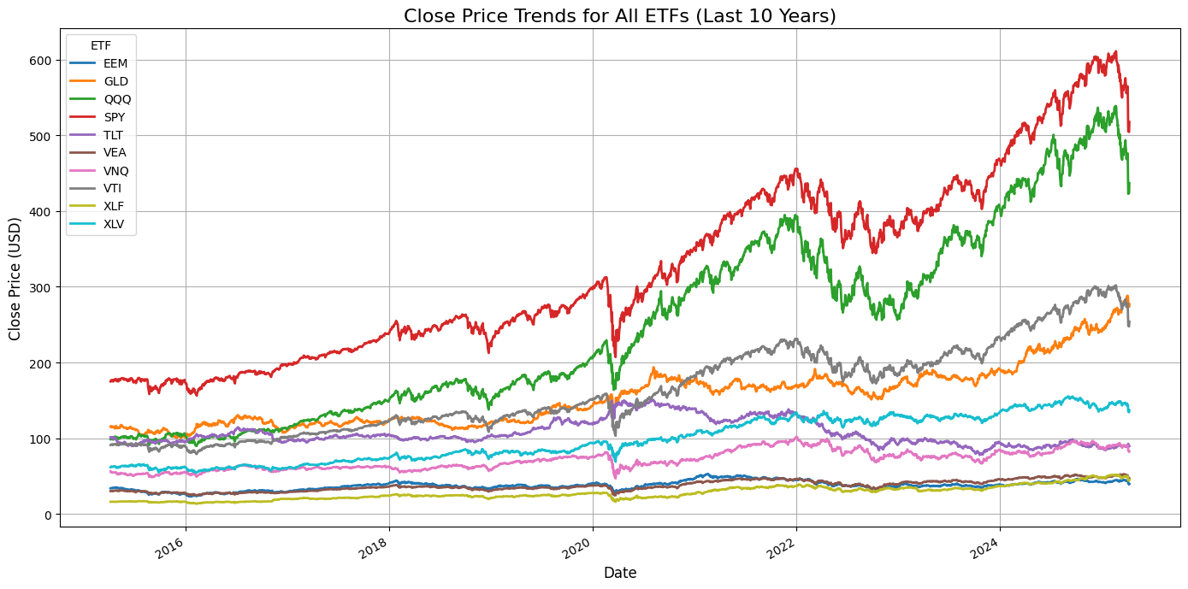
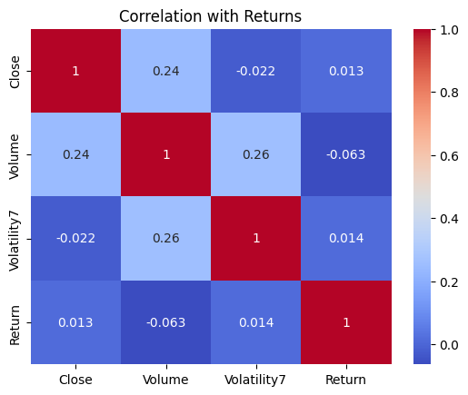
Exploratory Data Analysis
Close Price Trends
SPY, QQQ shows strong upwards trends especially post 2020.
GLD, VTI shows stable and consistent growth
EEM, VEA, XLF show fluctuating growth with some flat performance
TLT, VNQ shows cyclical trend
XLV show moderate and steady growth, outperform other sectors
Correlation of Daily Returns Between ETFs
SPY, QQQ and VTI have very high correlation (between 0.93-1.00) – similar market exposure – broadly tracks large cap US equities.
VEA is highly correlated with SPY and VTI – showing that international developed market often move with US market trends.
GLD shows low correlation to all equities ETF, reinforcing its role as hedging asset.
TLT has negative correlation to most equities ETF, making it useful for risk balancing
XLV is moderately correlated to equities ETF, suggesting some alignment but with independent dynamics.
Correlation with Returns
Close Vs Volume : Moderate positive Correlation
Volatility Vs Volume : Also moderately positive correlation
Close Vs Volatility & Return : Zero correlation, prices levels do not directly predict volatility or returns
Volume Vs Return: Negative, marginal tendencies for high volumes with lower returns
Returns has very low correlations with others, confirming independency and noisy.

Slide 10
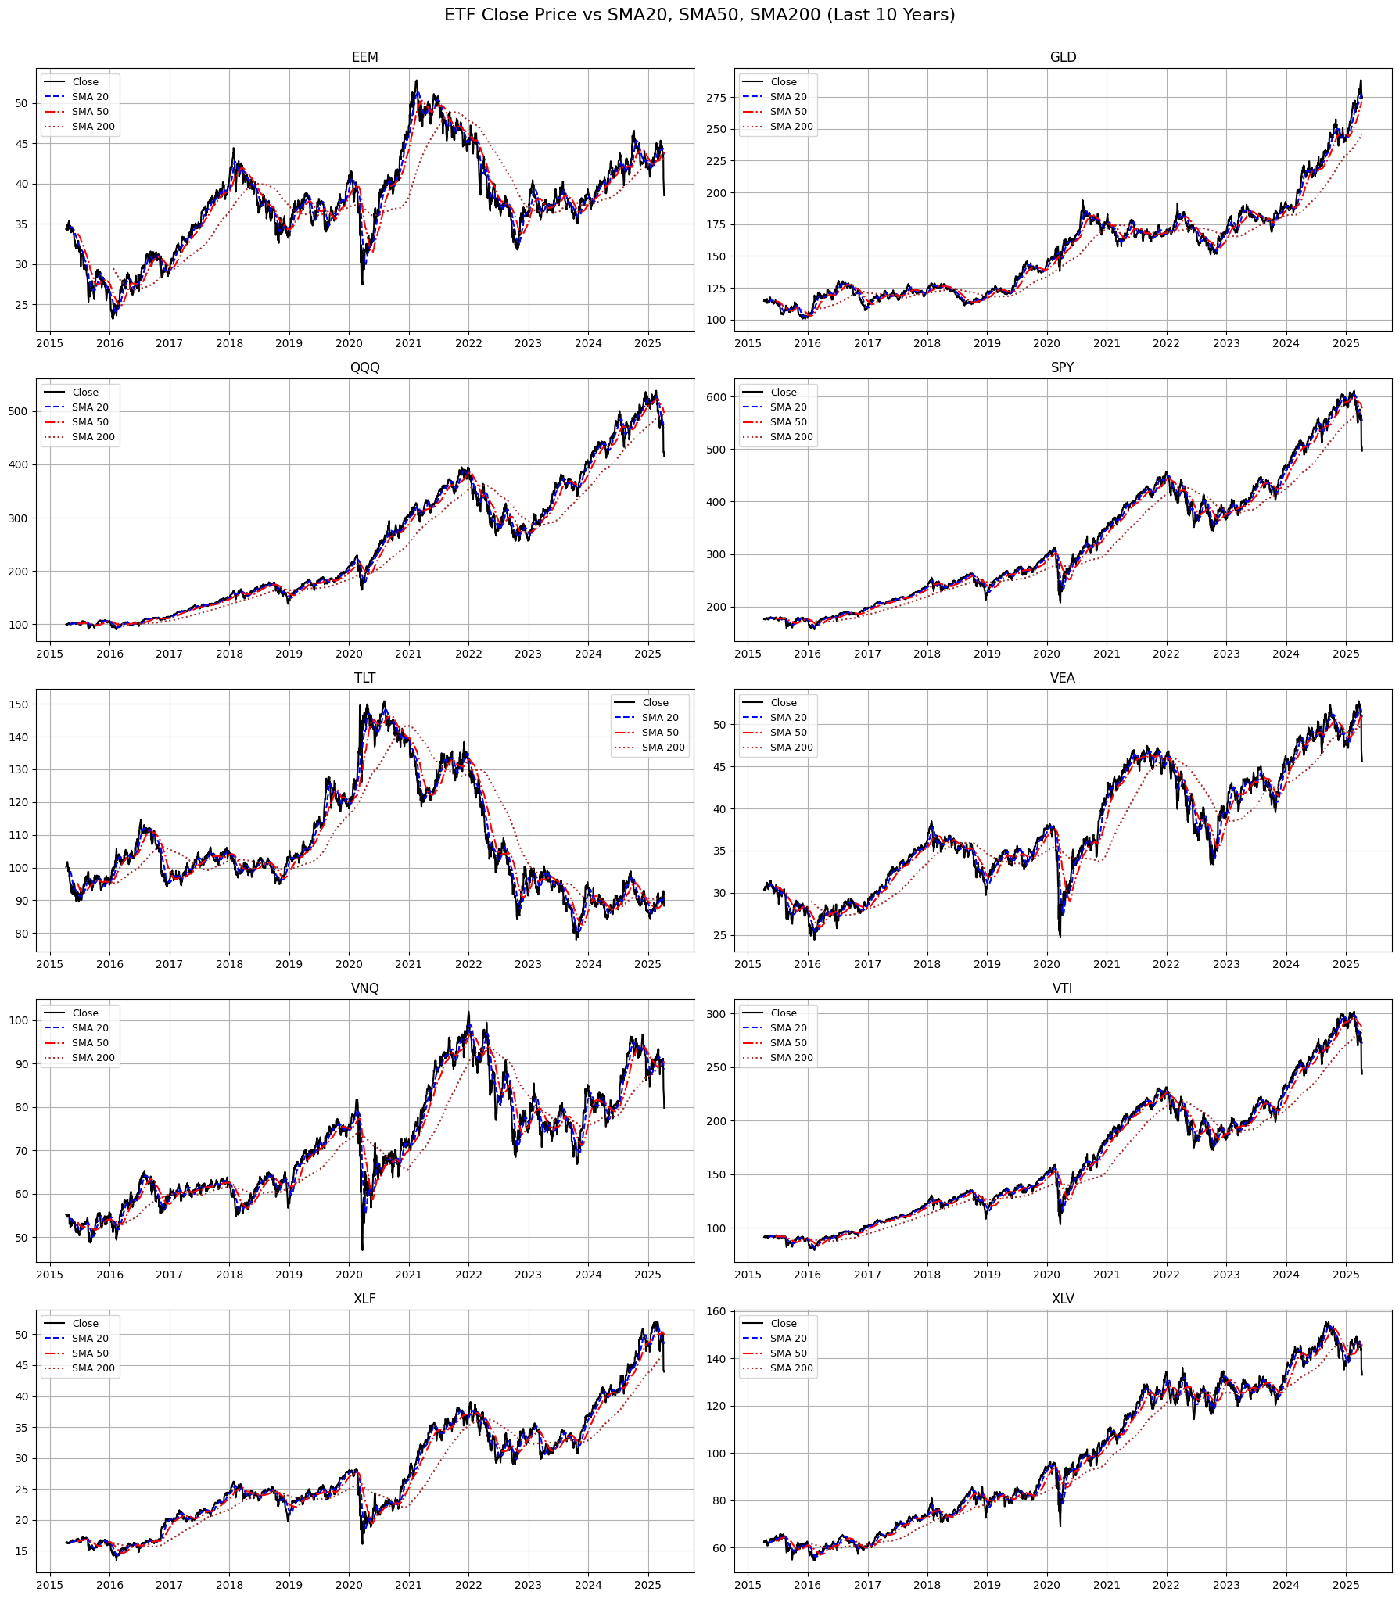
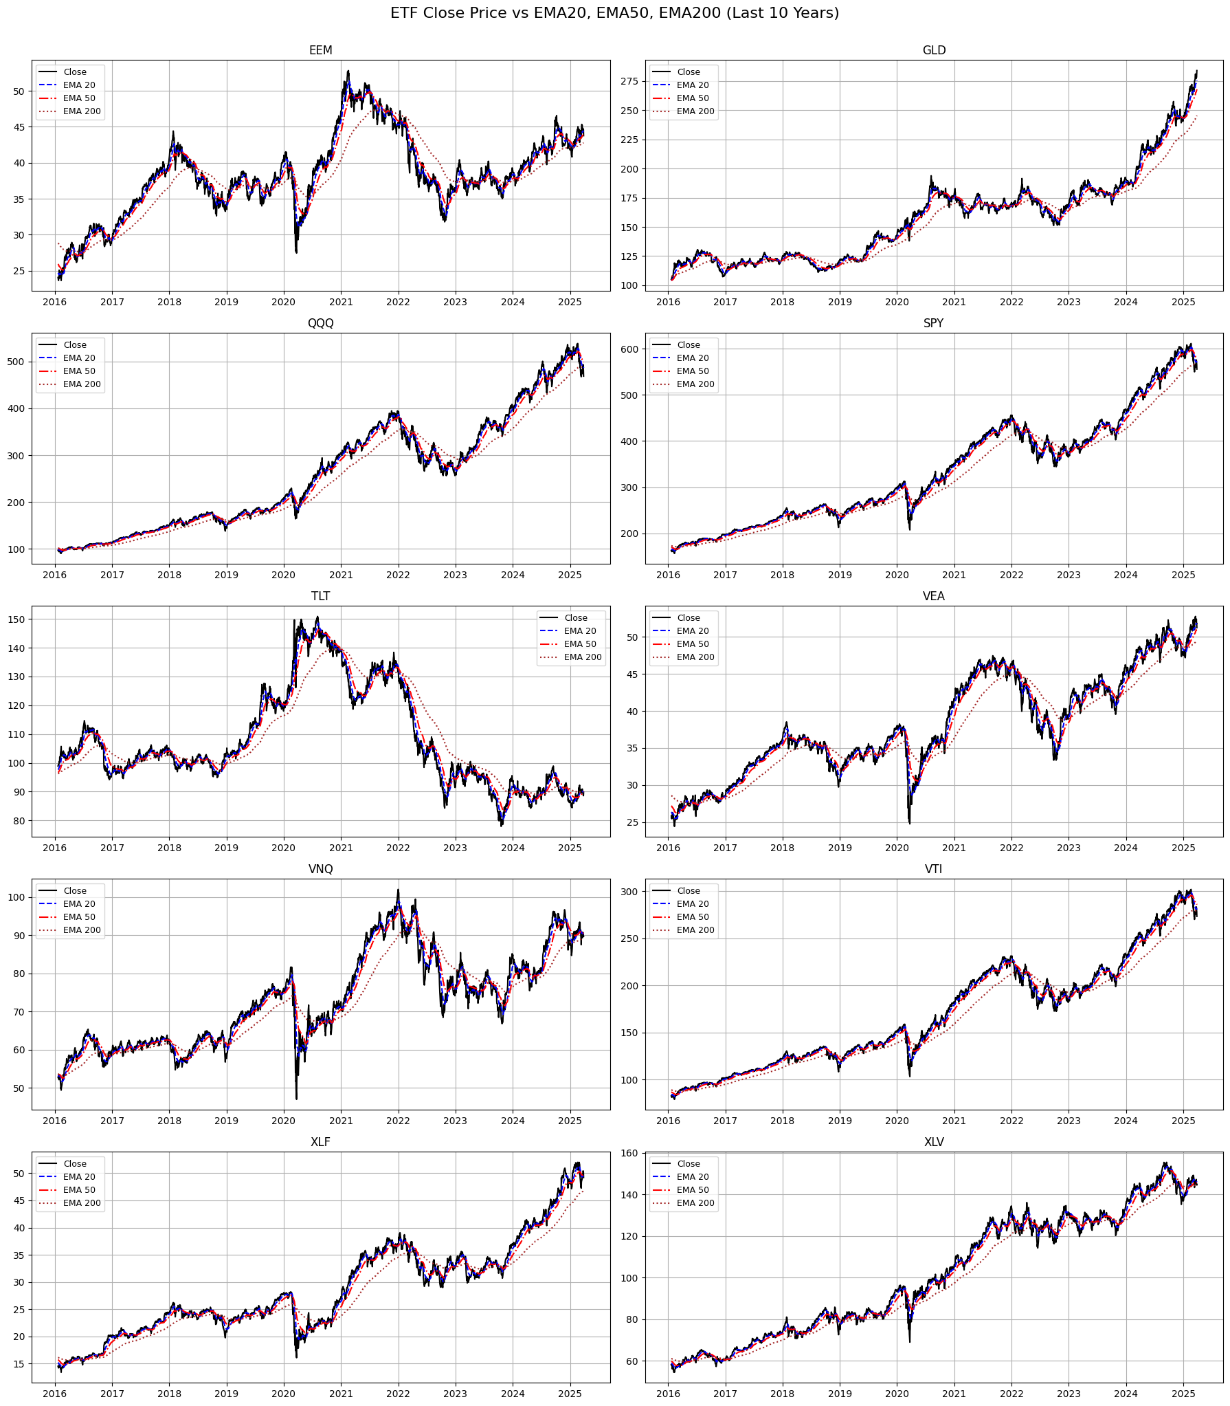
Exploratory Data Analysis
ETF | SMA | EMA
QQQ, SPY, VTI | Strong upward trend – implies bullish momentum | Strong upward trend – long term growth
EEM, VNQ, TLT, VEA | Volatile and cyclic trends with crossovers | Volatile pattern, dip visible during COVID
TLT | Sharp peak during risk averse period, but decline during rising interest rate. | Cyclic trends during market uncertainties
Aspects | SMA (Simple Moving Average) | EMA (Exponential Moving Average)
Responsiveness | Reacts Slower to price change due to equal weights | Reacts faster to recent price change as it has heavier weight
Lag | Introduces more lag, especially in short term. Hence better for long term investors who want stable view on trends. | Less lag, captures turning points. Better for active traders that react to early momentum shifts
Trends | Smooth but sometime delayed reaction to upward /downward trend | Tracks trends more aggressively, providing early signals

Slide 11
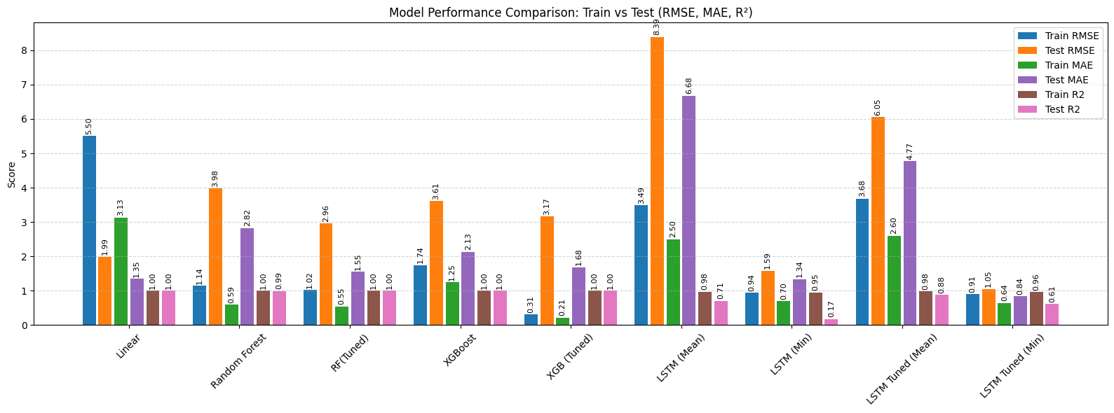
Model Evaluation - Price Prediction (7 days)
Models used: Linear Regression, Random Forest Regression, Random Forest (Tuned), XGBoost Regression, XGB Boost (Tuned), LSTM Regression, LSTM (Tuned)
LSTM (Mean)
Underfitting and generalization issue. Highest test score. Worst performer overall.
LSTM (Min)
Great RMSE/MAE, but low R2 test values, unable to explain on unseen data.
LSTM Tuned (Mean)
Better than basic LSTM, but still has gap between train & test. Some generalization issues.
LSTM Tuned (Min)
Very Solid performer. Low RMSE / MAE and good generalization. R2 test is still not best. Most balance LSTM
Dropout rate = 0.1 to 0.5
Tunable unit = 64, 128
Early stopping = 5
LR:
Huge performance gaps in RMSE suggesting overfitting.
R2 looks good, however due to high training error vs low test error suggests data leakage.
RF:
Very strong overfitting. Low train error, but high test error.
R2 looks good.
RF (Tuned):
Improves generalization, overfitting reduces. Gaps still exists, High R2, Solid model – reliable and balanced.
XGBoost:
Overfitting compared to RF(tuned). Higher test results than RF (tuned)
XGB (Tuned):
Tight training fit (low RMSE). Borderline overfitting

Slide 12
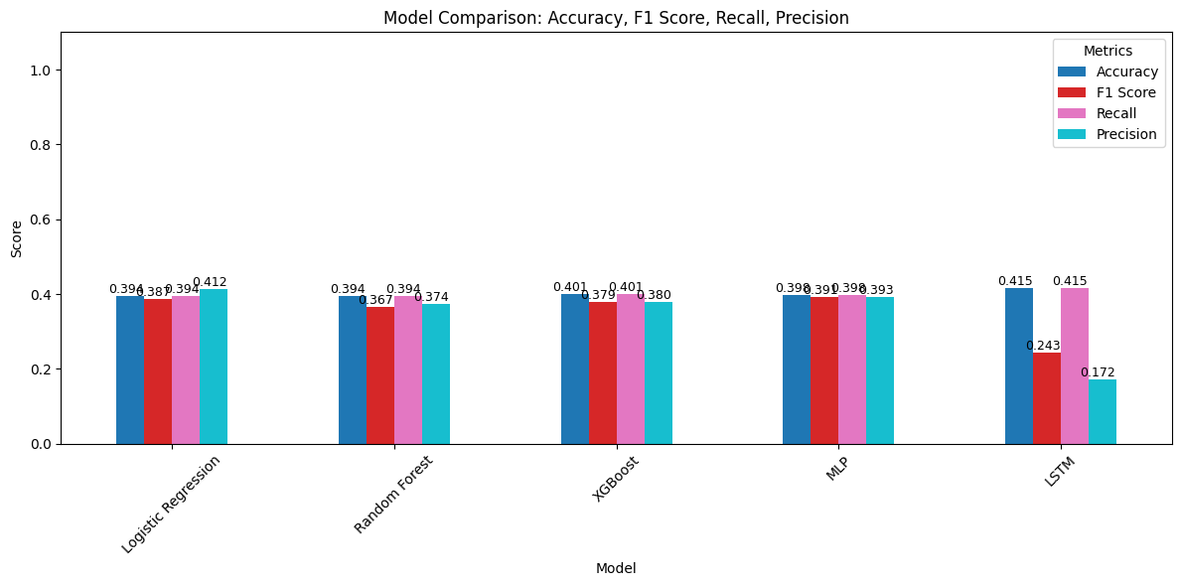
Model Evaluation - Signal Classification Prediction (7 days) (Buy / Hold / Sell)
Models used: Logistic Regression, Random Forest Classification, XGBoost Classification, MLP Classification, LSTM Classification
Accuracy
LSTM leads in accuracy
F1 Score
MLP outperforms all other models in F1 score, a better balanced between precision and recall.
LSTM has poor F1 score, predictions are likely skewed / likely overfit.
Recall
LSTM and Xboost shows high recall
MLP and Logistic Regression has strong recall as well.
Precision
Logistic Regression has highest precision, suggesting reliable prediction.
LSTM shows lowest precision
MLP Classification is the most balanced across all metrics, making it the best model for signal classification.

Slide 13
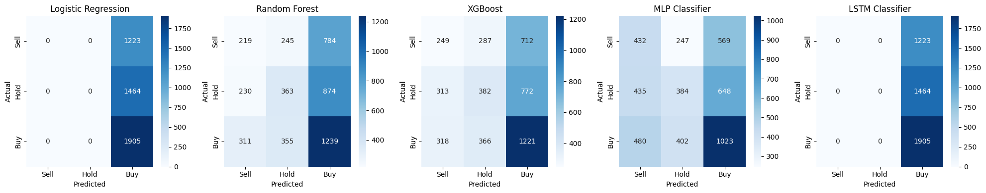
Model Evaluation - Signal Classification Prediction (7 days) (Buy / Hold / Sell)
Models used: Logistic Regression, Random Forest Classification, XGBoost Classification, MLP Classification, LSTM Classification
Logistic Regression | Random Forest | XGBoost | MLP | LTSM
Prediction Bias – Only predicts Buys | Improved class recognition, able to predict across all 3 classes | Balanced performance, handles better than LR and RF. | Strongest Classifier of all. Best class separation across all 3 classes. | Prediction Bias – Only predicts Buys
Not learning the class boundaries | Buy is still dominant. Mis-classifies a lot of sell and hold as but buy | Bit biased towards Buy, but also predicts sell / hold well. | Evenly distributed of prediction across all classes | Overfitting or poor learning

Slide 14
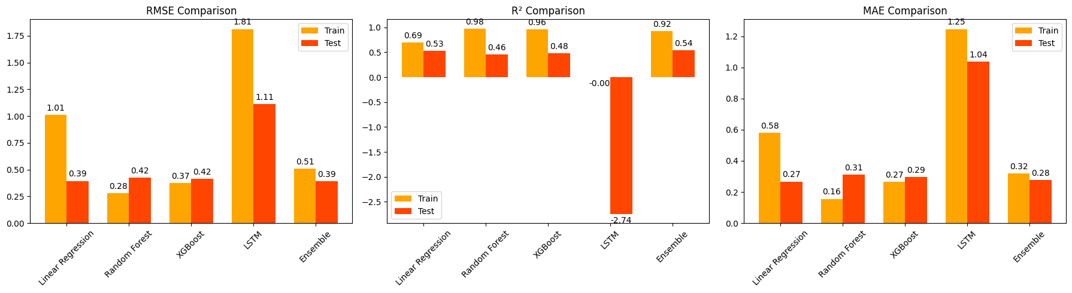
Model Evaluation - Volatility Prediction (7 days)
Models used: Linear Regression, Random Forest Regression, XGBoost Regression, LSTM Regression, Ensemble (LR + RF + XGB)
Good Fit model : Ensemble
Lowest RMSE & MAE on test data
High R2 on both train & test
Good generalization with no sign of overfitting
Overfit Model : Random Forest, XGBoost
High Training accuracy, but worse test results
Underfit Model : Linear Regression
Performs well on test, but weaker on train
Poor Performance : LSTM
High errors and negative coefficient, possible due to noise in features, insufficient tuning

Slide 15
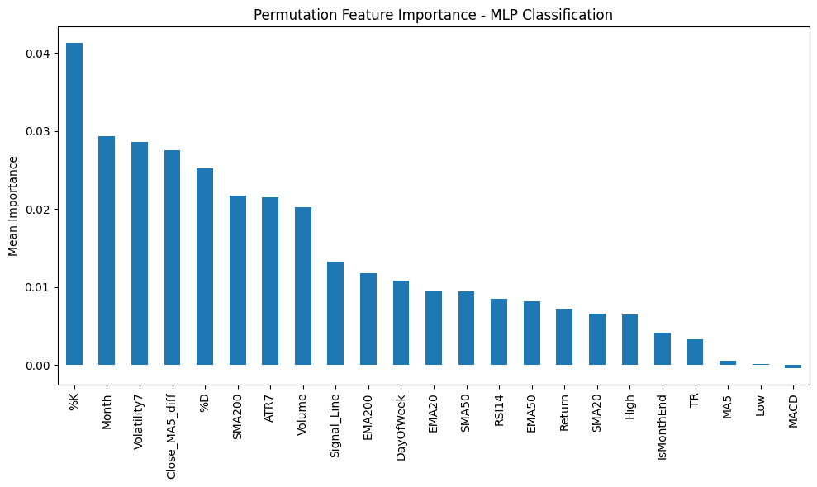
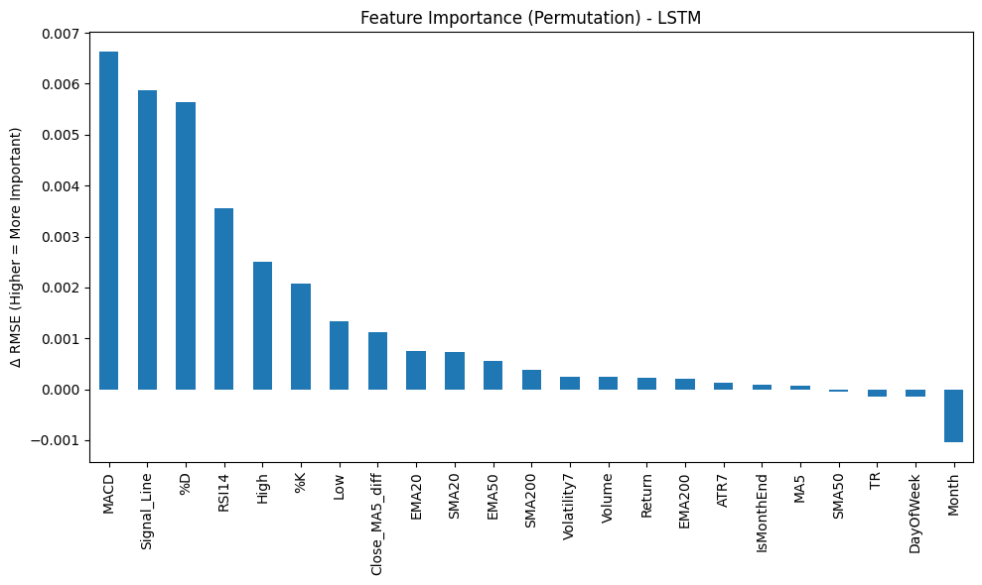
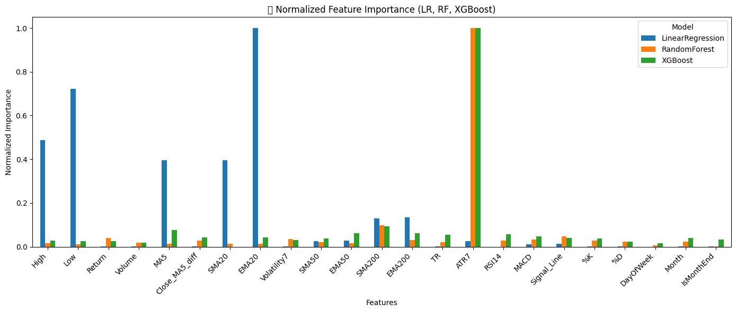
Feature Importance
Signal Momentum, %K, SMA, Volatility, ATR. Inclusion of Month suggests seasonal pattern in trade signals.
MACD, Signal, RSI14, %K, %D are classic technical indicators and core for trend and momentum.
High, Low, Close capture short term price movements.
ATR, TR, Volatility are all volatility estimators.
RSI14, Return, past performance can also impact future volatility shifts.

Slide 16
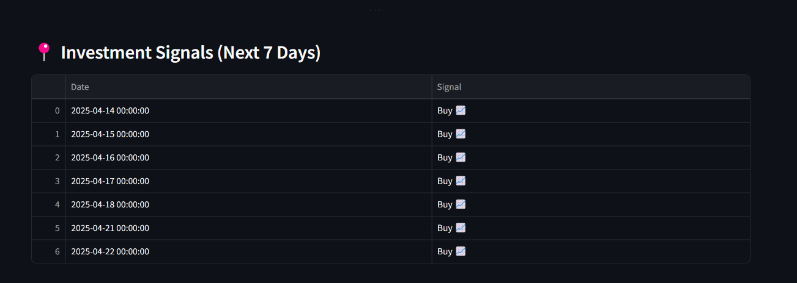
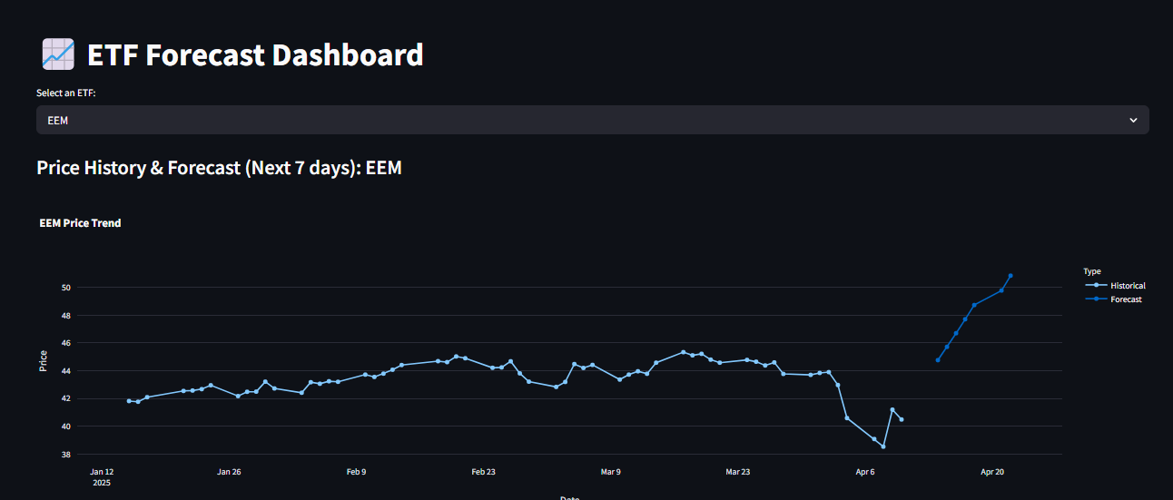
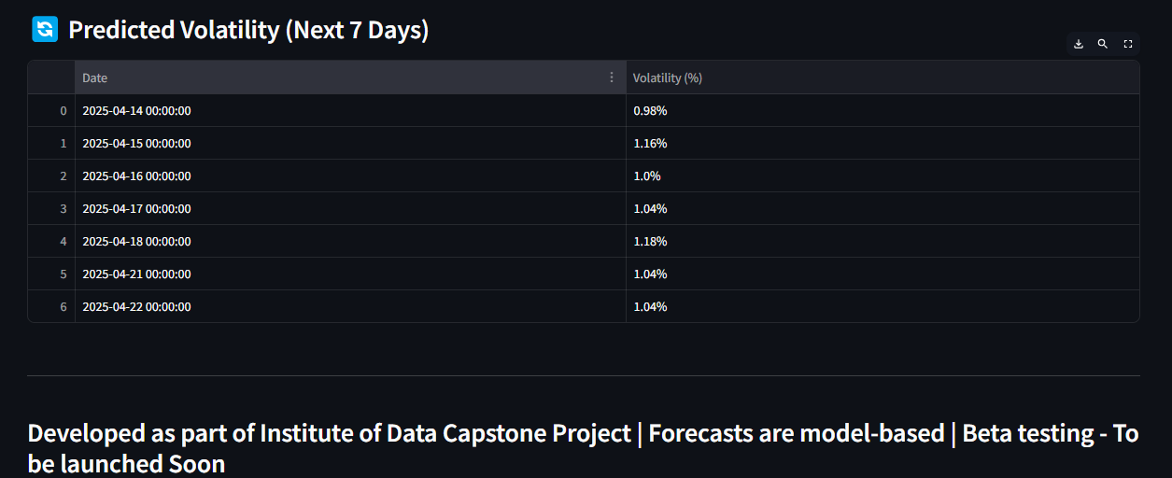
Deployment - Streamlit
ETF Forecast Dashboard · Streamlit
Indicates whether the investor should Buy / Sell / Hold for next 7 days
Predicts Future prices for next 7 days
Predicts Volatility for next 7 days

Slide 17
Summary & Conclusion
Problem Statement :
Is the price likely to grow in the coming days ?
Should I act on this information ?
Will my decision be stable for some time ? Should I be prepared for big swing or will this jump around a lot ?
Goal :
Forecasting where ETF prices may move in the next 7 days
Providing easy-to-understand investment signals – Buy, Hold or Sell in the next 7 days.
Alerting users about expected market volatility in next 7 days to guide risk awareness
Models Used
Linear / Logistic Regression / Random Forest, XGBoost, LSTM, MLP…..
Base Features
High, Low, Close, Open, Volumes, Ticker, Date
Deploy in Streamlit
Feature Engineering
Returns, Volatility, RSI, MACD, SMA, EMA, True Range, Average True Return…..
Exploratory Data Analysis
Forecast 7 day Close price, Signals, Volatility
Hyperparameter

Slide 18
Way Forward “The more I learn, the more I realize how much I don’t know” Albert Einstein
Stakeholder Feedback
Review Feature Engineering
Real time data integration
Integration with Trading platforms
Real Time Prediction
Deploy on Azure / GCP / AWS
NLP model Sentiment Analysis
Interactive App / Dashboard
Portfolio Optimization
Auto Model training

Slide 19
Thank you, Mahesh, Preenita, Rei and our cohort
Girish Pandit
Curious Investor & Learner

